Slide 1
PRESENTATION BY ALEX PORRAS
2024

Slide 2
Overview
WHO WE ARE
NORTH PORT, FL - AREA, WHO’S MOVING TO NORTH PORT, WHAT IS COMING TO THE AREA
OUR CONSTRUCTION METHODOLOGY
MY NEW RENTAL- PROPERTY MANAGEMENT / BROKERAGE
QUESTIONS

Slide 3
The Builder’s Story
Brock's involvement in the construction industry began at the young age of 18. His journey started by engaging in wholesaling properties obtained from the county clerk's office during the aftermath of the 2008 recession, all while pursuing his high school education. As time progressed, an opportunity arose to collaborate with an investment fund keen on developing 10 homes. Recognizing his need for expertise, Brock partnered with his father, an experienced professional with over two decades of home-building experience. While managing the business aspects, Brock dedicated himself to mastering the nuances of construction. The successful completion of the initial project propelled his venture forward. By late 2016, he grasped the importance of wealth accumulation through property ownership. Presently, boasting a record of over 2000 builds and a real estate portfolio comprising 200 properties, our goal is to construct homes for retention and sale to likeminded investors seeking to expand their wealth.

Slide 4
North Port, FL
SECOND FASTEST GROWING CITY
5TH WEALTHIEST COUNTY
HIGHLY RATED SCHOOL DISTRICT
LINK #1
LINK #3
LINK #4
LINK #2

Slide 5
Why are People Moving to North Port, FL?
Lower than Average Crime Rate
Ranking in the 78th Percentile for Safety
Peaceful Neighborhoods

Slide 6
What is Coming to North Port, FL?
30 commercial Projects including
Shopping centers,
2 Medical Centers,
1 Medical building,
1 behavior hospital,
Costco and more!
Current Development Map

Slide 7
Model
Home
3428 W Price Blvd,
North Port, FL 34286

Slide 8
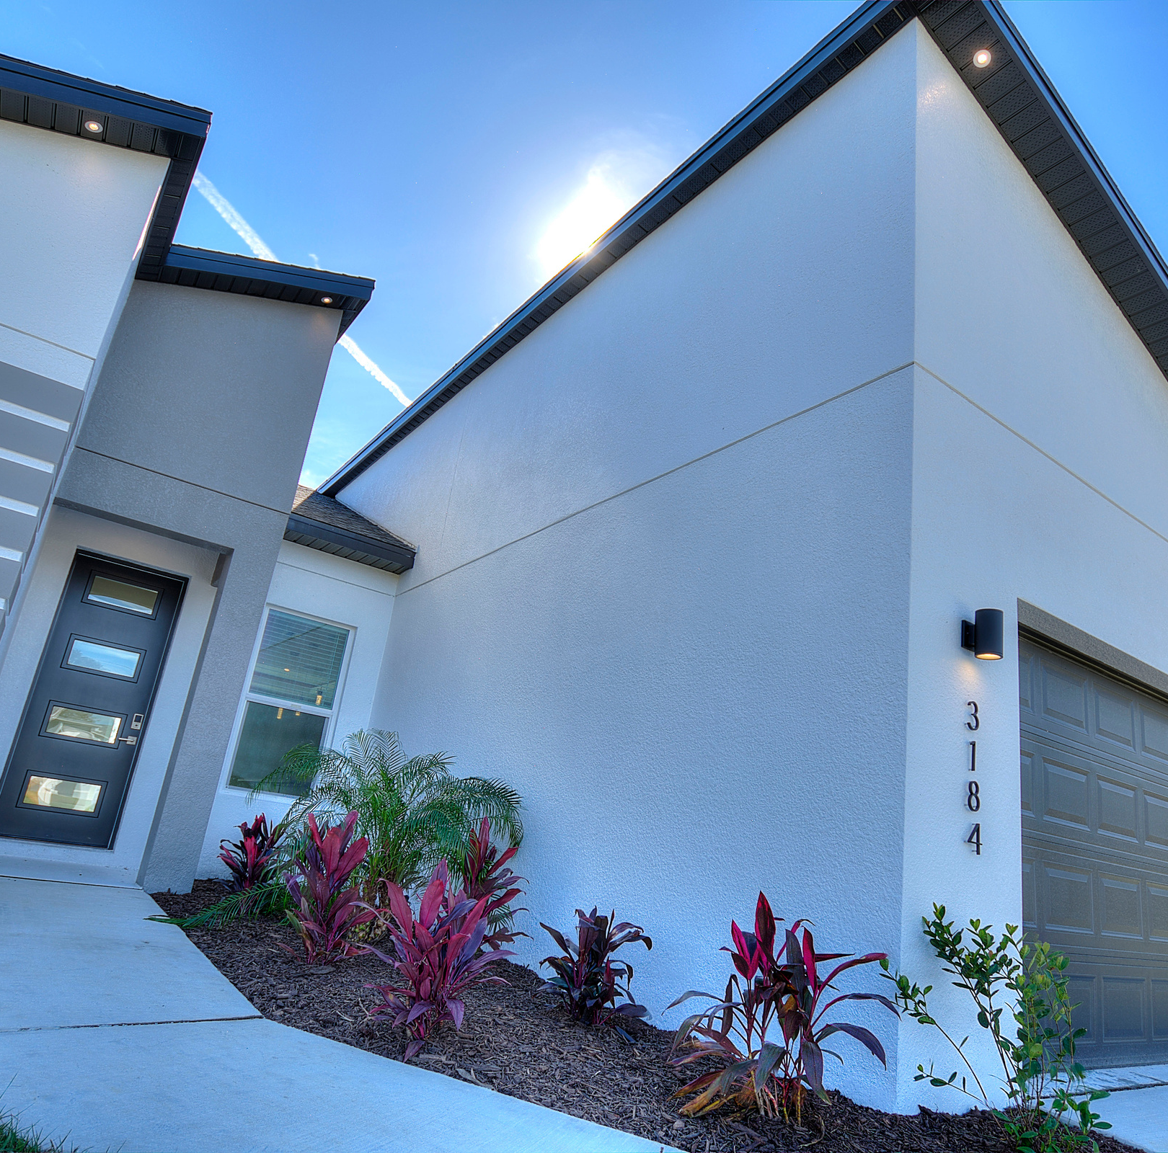
Our Properties
4 Bedrooms
2 Bathrooms
1,717 Square Feet
2 Car Garage

Slide 9
Exterior Design
Modern finishes that are built for the future.
UPGRADED SHINGLES
SLOPED ROOF FOR WATER DRAINAGE
HURRICANE IMPACT WINDOWS
NO FLOOD ZONES
EXTERIOR LIGHTING
Built Above Code

Slide 10
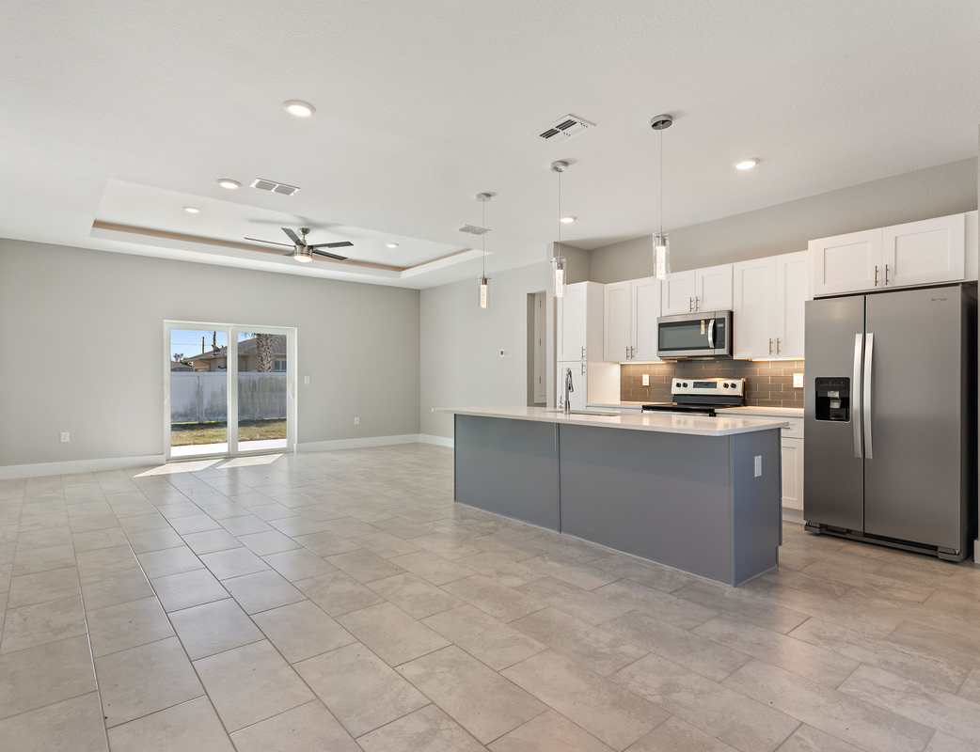
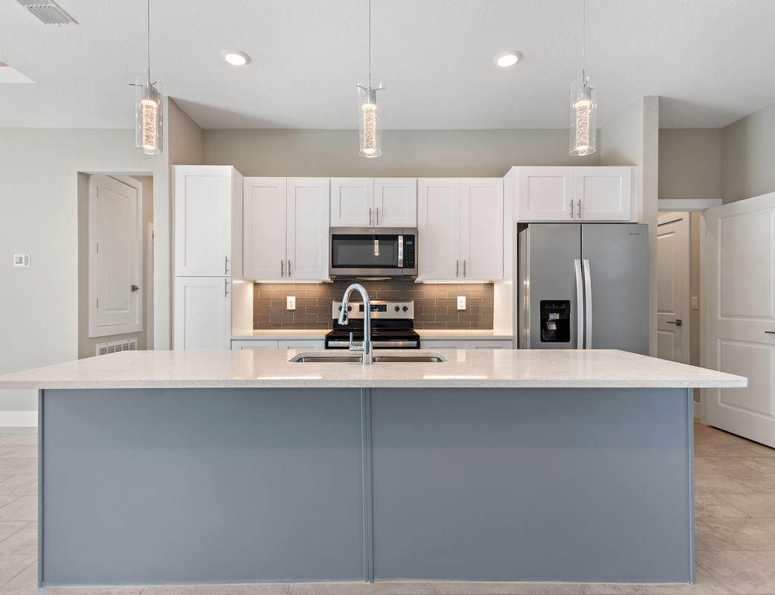
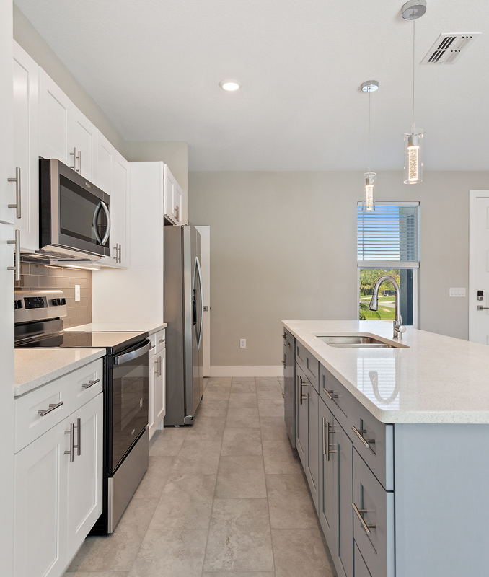
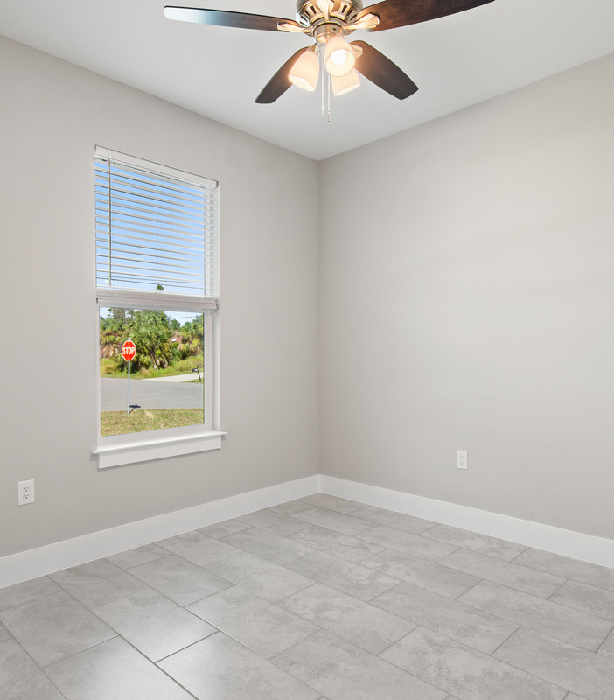
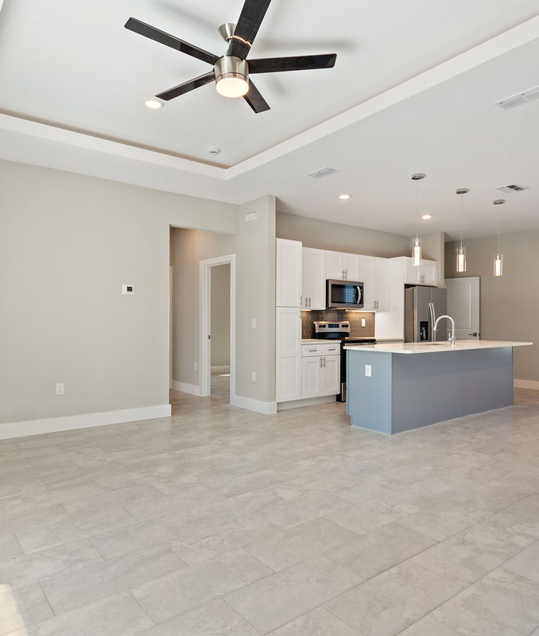
Interior Finishes
CERAMIC TILE THROUGHT THE ENTIRE HOME
2 INCH QUARTZ COUNTERTOPS IN KITCHEN & BATHS
LED LIGHTS IN THE TRAY CEILINGS
CEILING FANS
2 TONED REAL WOOD CABINETS
PENDANT LIGHTS

Slide 11
My New Rental
OUR PROPERTY MANAGEMENT COMPANY HANDLES ALL OPERATIONS INTERNALLY, PROVIDING A HASSLE-FREE INVESTMENT EXPERIENCE. WE CURRENTLY MANAGE CLOSE TO 300 PROPERTIES, OUR PORTFOLIO CONTINUES TO EXPAND DAILY.

Slide 12
Our Services
RENT COLLECTION
Preparation of Monthly Financial & Year End Statements
Coordination of Maintenance and/or Warranty Issues
Credit and Criminal Tenant Screenings
PRE-OCCUPANCY PHOTOS
INTERIOR AND EXTERIOR INSPECTIONS
ALL-INCLUSIVE WEBSITE
E-Mail Communications
Leasing Services
Marketing Program
Optional Direct Deposit

Slide 13
Questions?

